Slide 1


Slide 2

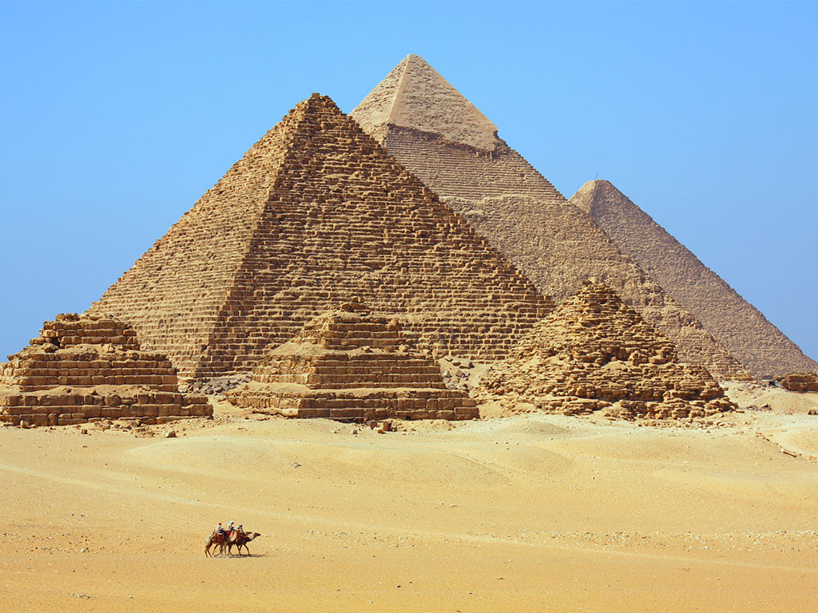
The Egyptians
The Egyptians used simple machines to build the magnificent pyramids and structures in the Ancient world.

Slide 3
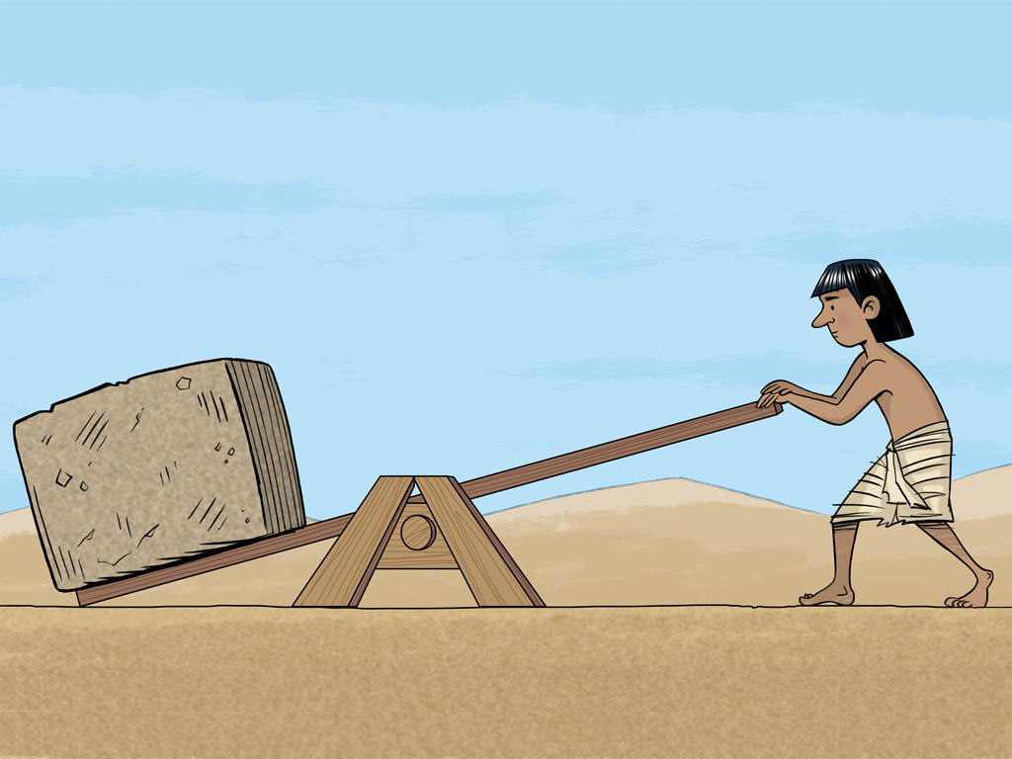
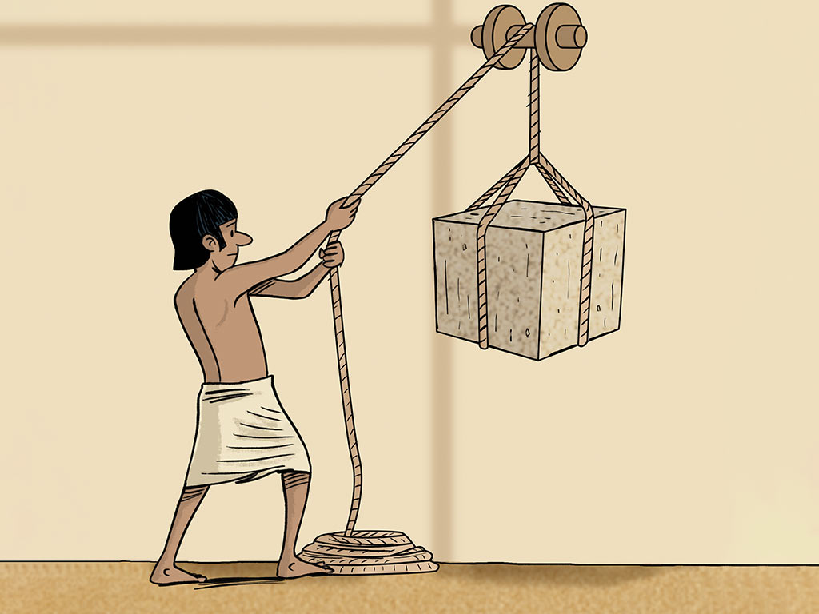
Levers and pulleys
These simple machines are still used today in many everyday activities.
Two of them are called levers and pulleys.

Slide 4
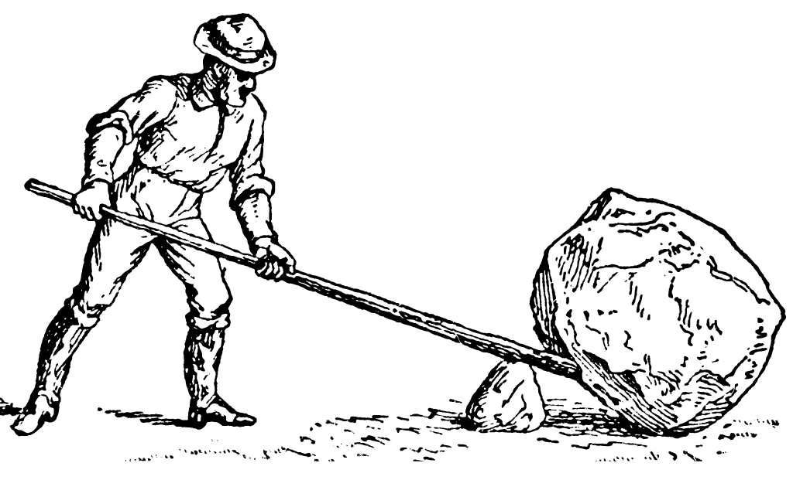
Levers
A lever is a beam that rests on a support called a fulcrum.
The fulcrum allows the lever to pivot.
This allows a load to be lifted using less force.

Slide 5
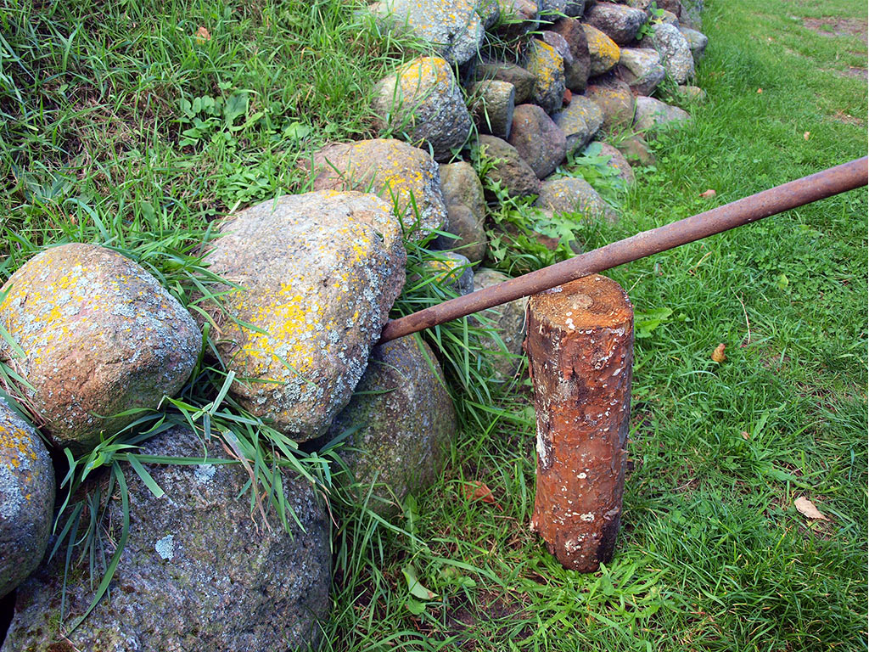
Levers
Here, the fulcrum is a log, the beam is an iron bar and the load being lifted is a large stone.

Slide 6

Levers
A see saw is an example of a simple machine.
It works as a lever.
Can you see where the fulcrum, beam and load are?

Slide 7
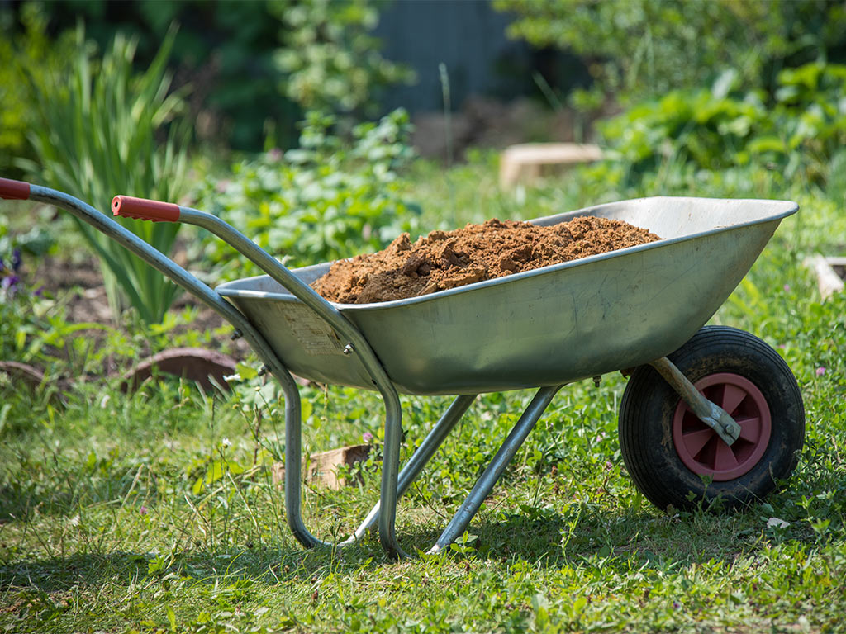
Levers
A wheelbarrow is another example of a simple machine that works as a lever.
Can you see where the fulcrum, beam and load are?
Where would the effort or force be applied?

Slide 8
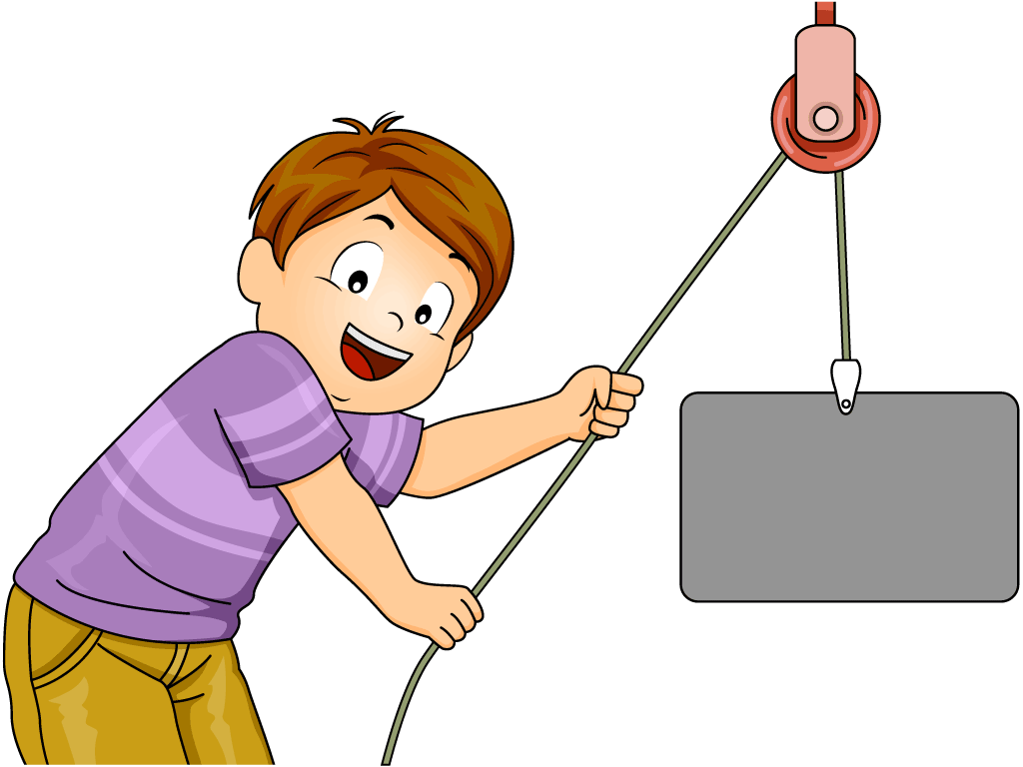
Pulleys
A pulley is a simple machine that is used for lifting heavy objects.

Slide 9
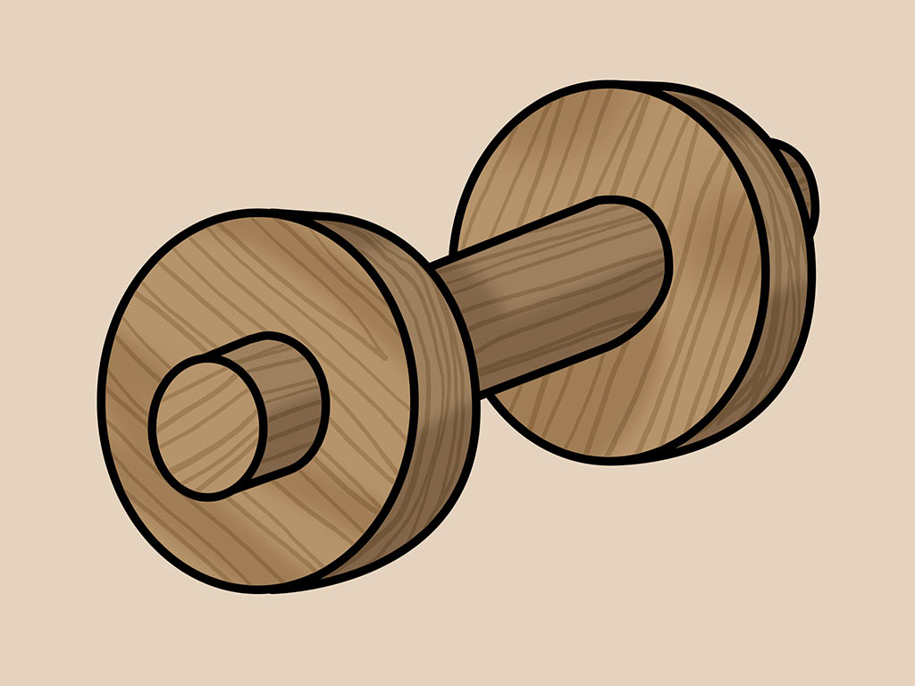
Pulleys
It has an axle and a wheel, and works with a rope, chain or cable.
wheel
axle

Slide 10
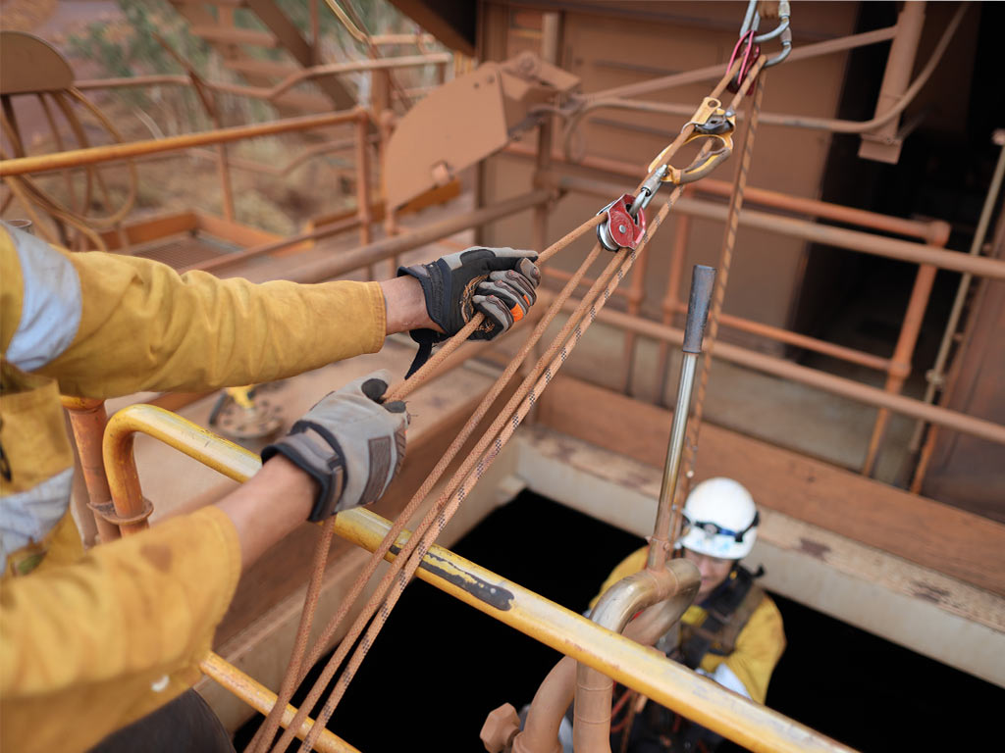
Pulleys
The force is applied by pulling on the rope.
That is how this simple machine gets its name – a pulley.

Slide 11
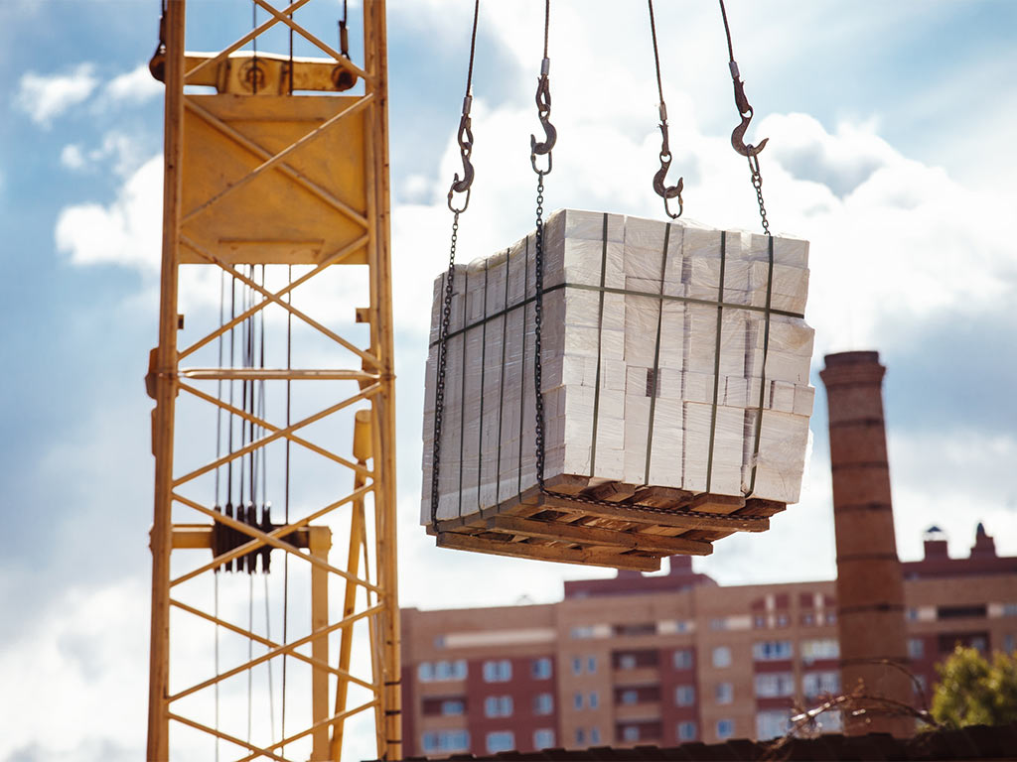
Pulleys
Today, cranes use pulleys to lift very heavy loads in construction.

Slide 12
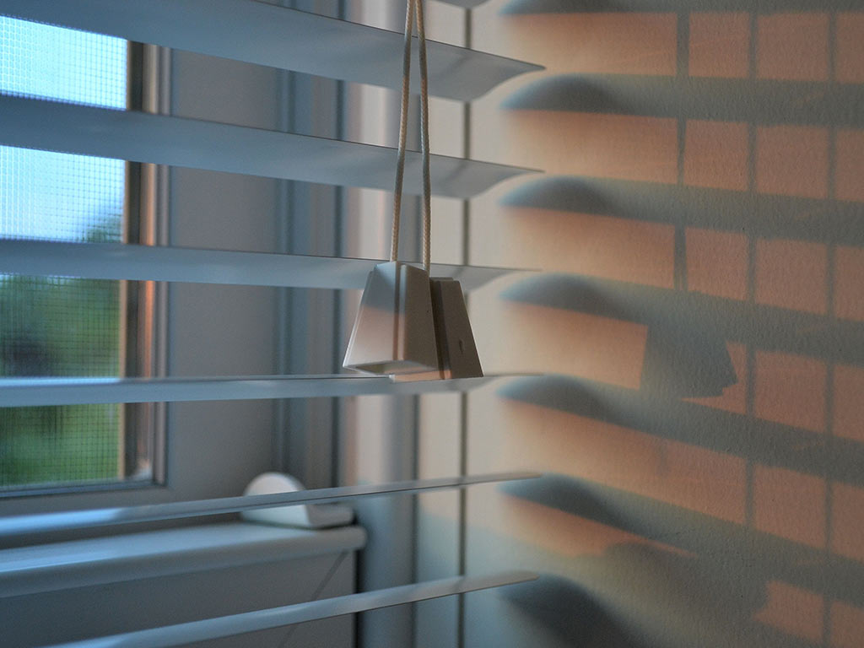
Pulleys
Pulleys can be found in items around the home too.

Slide 13
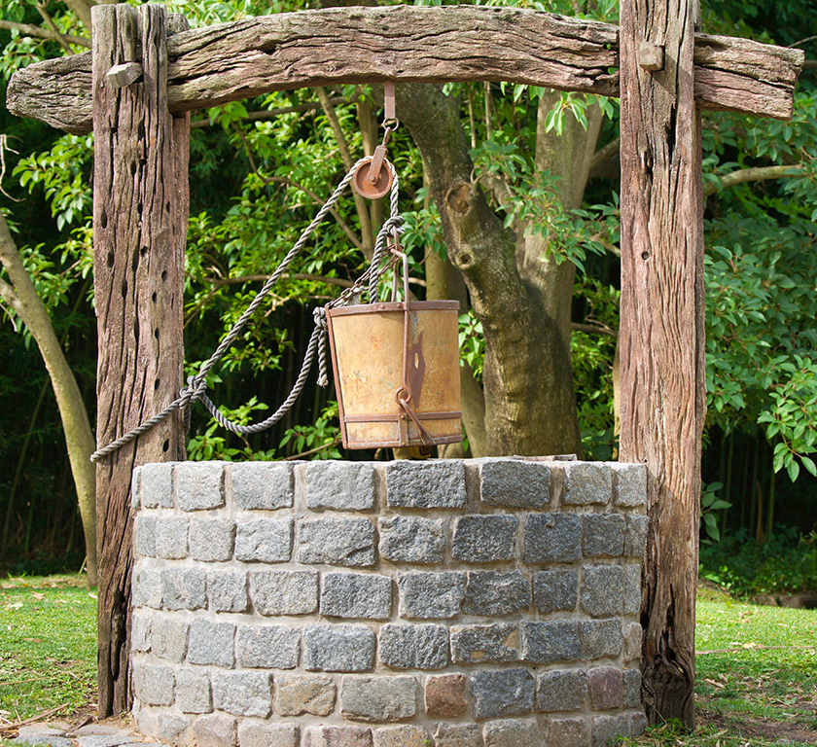
Let’s discuss
Which simple machine is used in this picture?
How does it work?

Slide 14
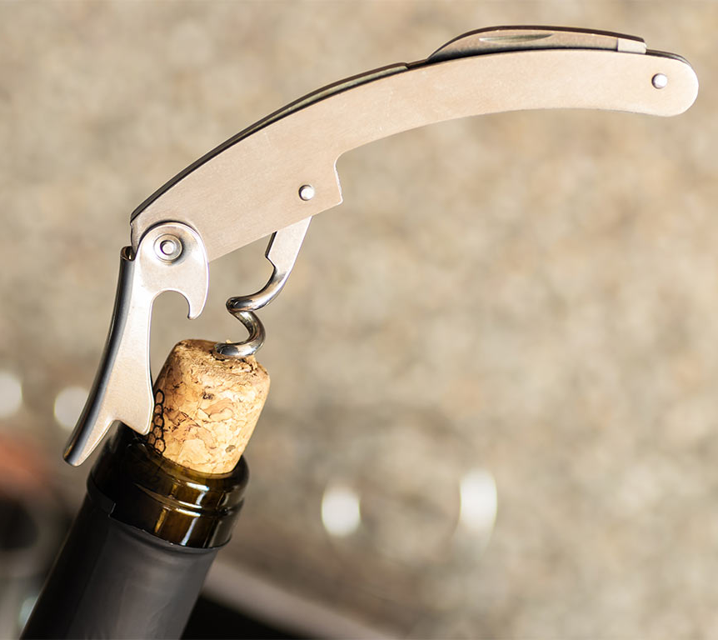
Let’s discuss
Which simple machine is in use here?
Is it a lever or a pulley?
How does it work?

Slide 15
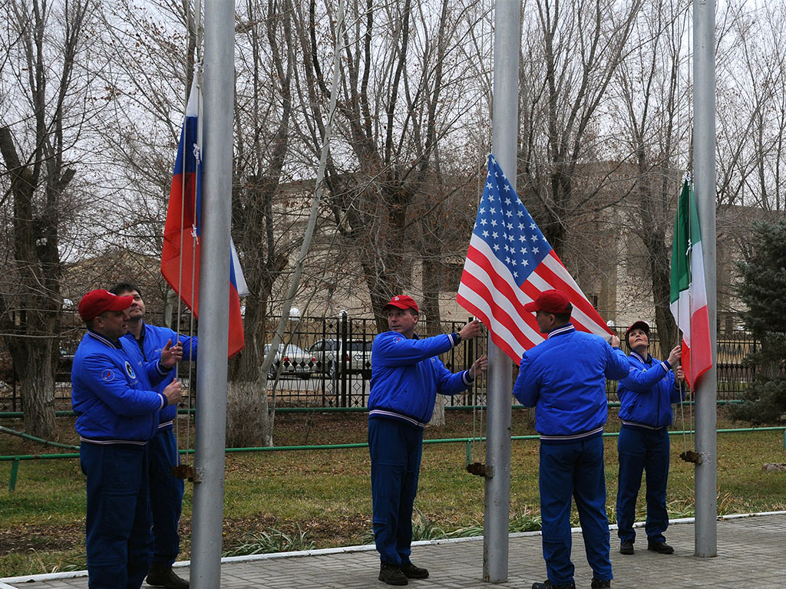
Let’s discuss
Which simple machine is used to raise or lower a flag on a flagpole?

Slide 16
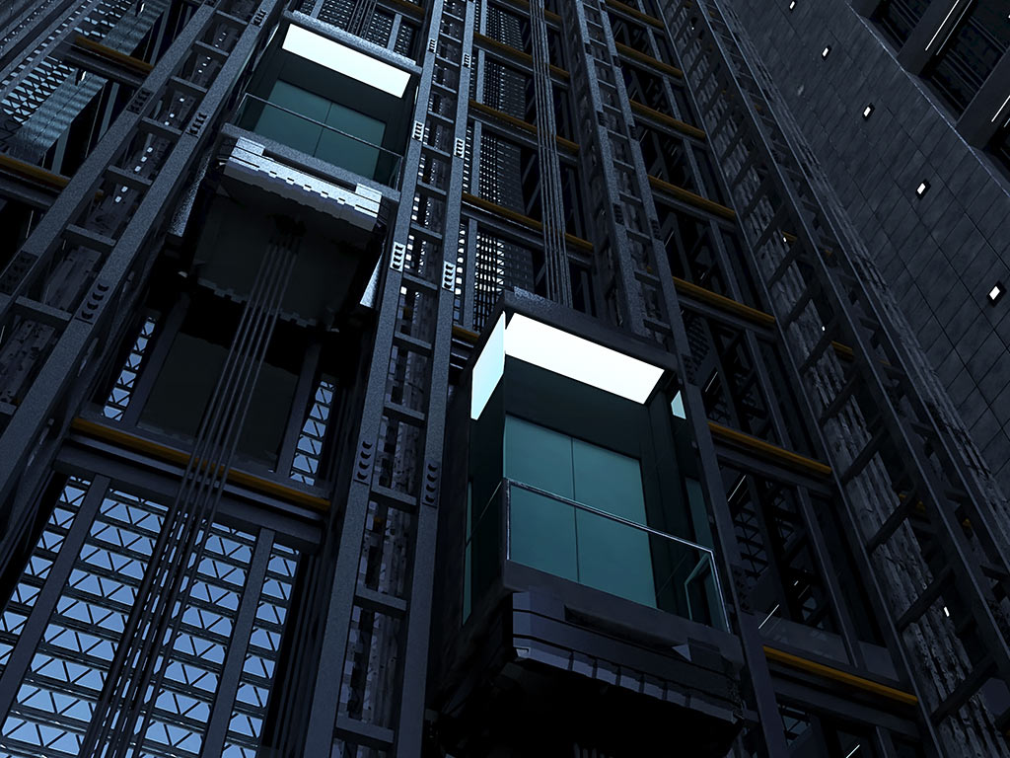
Let’s discuss
What simple machine allows a lift to move?

Slide 17

Let’s discuss
Which simple machine is in use here?

Slide 18
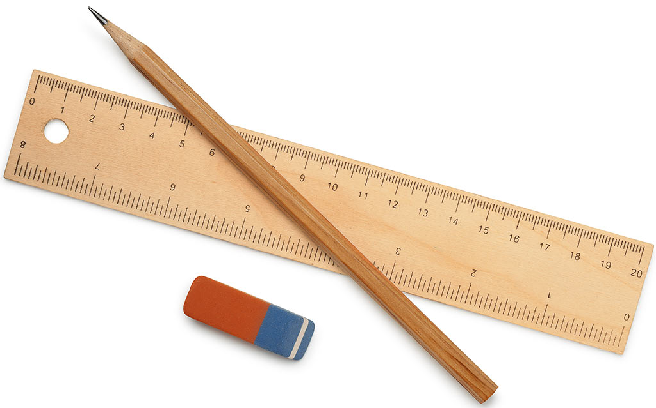
Challenge time!
Can you make a simple machine using just the contents of your pencil case?
How does it work?

Slide 19
Illustrations
Shutterstock
Beehive

